Slide 1

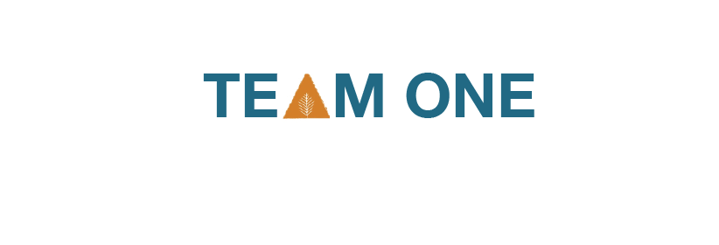
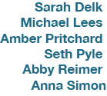

Slide 2

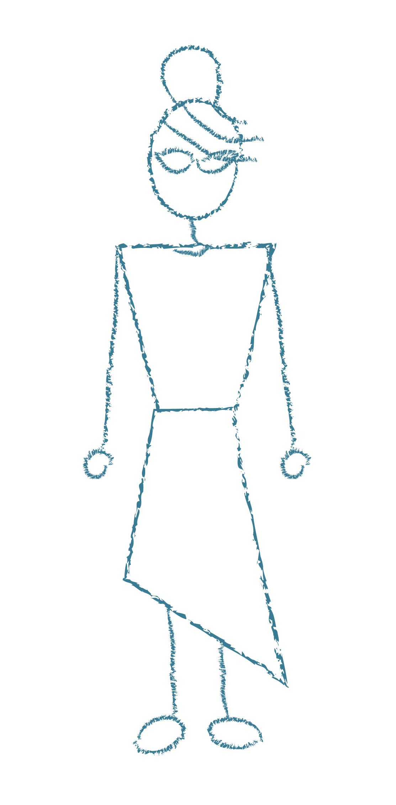


Slide 3


Slide 4

Current Situation
Industry Analysis
Consumer Insights
Market Strategy
Brand Identity and Multimedia
Promotions and Collaborations
Costs
Conclusions

Slide 5

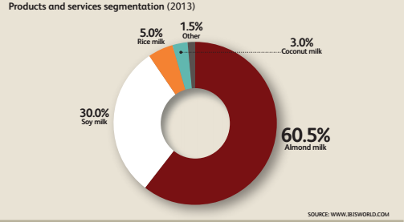
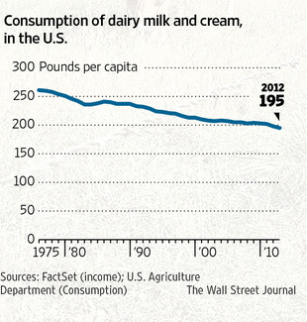
Dairy and soy
are declining
while almond milk
is booming.

Slide 6
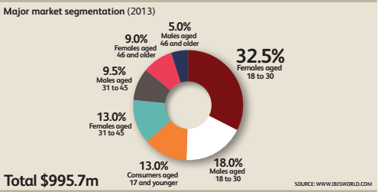
Women 18-30 make up the market majority, however men 18-30 are still significant.

Slide 7

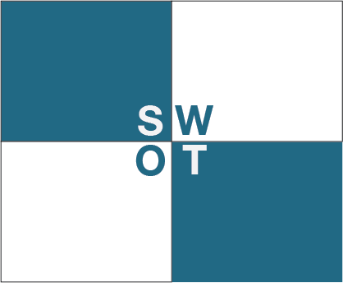
Creamier and healthier alternative to soy and almond.
One of two pecan milks in the nation
Environmentally sustainable product
No brand or product familiarity
Limited shelf life and distribution capabilities.
Partnering with local food businesses
Vacuum created by soy decline
Emergence of non-dairy market
Easily imitated
Expected fragmentation of non-dairy market
National brand price pressures

Slide 8

Native Beverage Company is one of two pecan-milk producers in the nation, offering a healthy and delicious dairy alternative while fostering a sense of community for adventurous food explorers in the Triangle area.

Slide 9
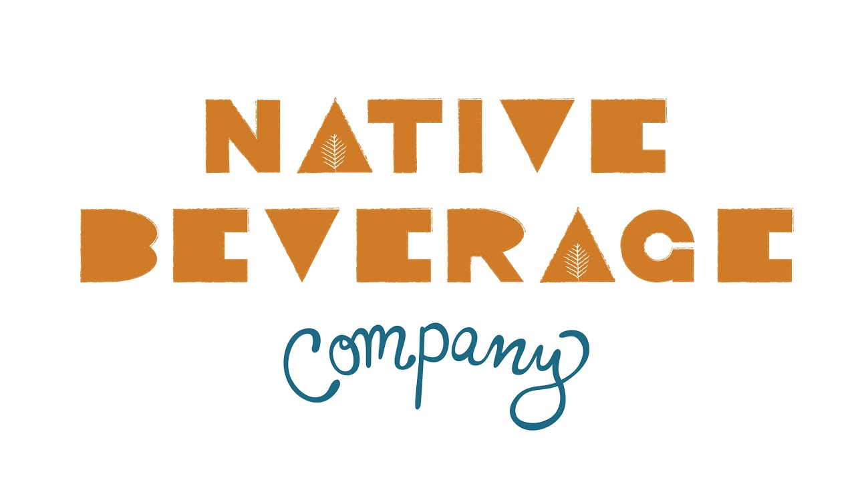

Slide 10

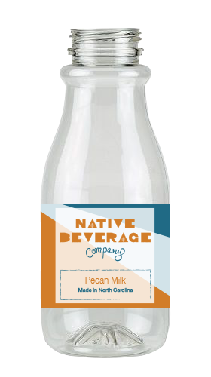
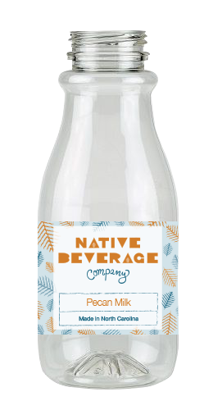
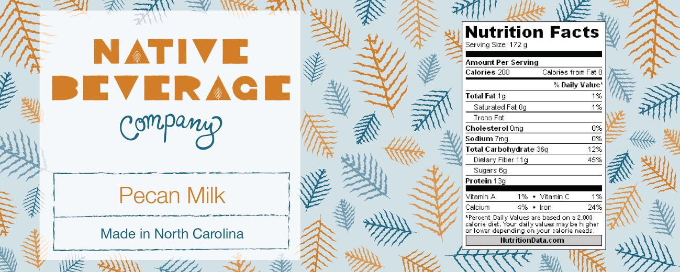
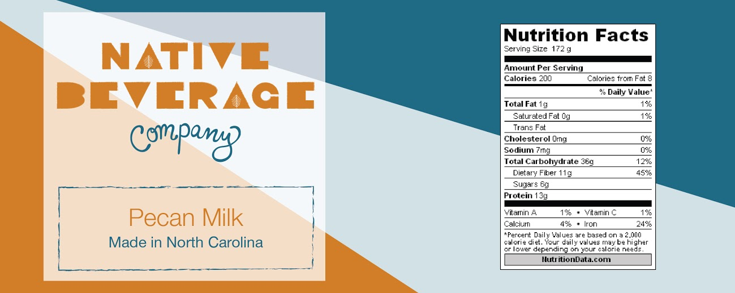

Slide 11


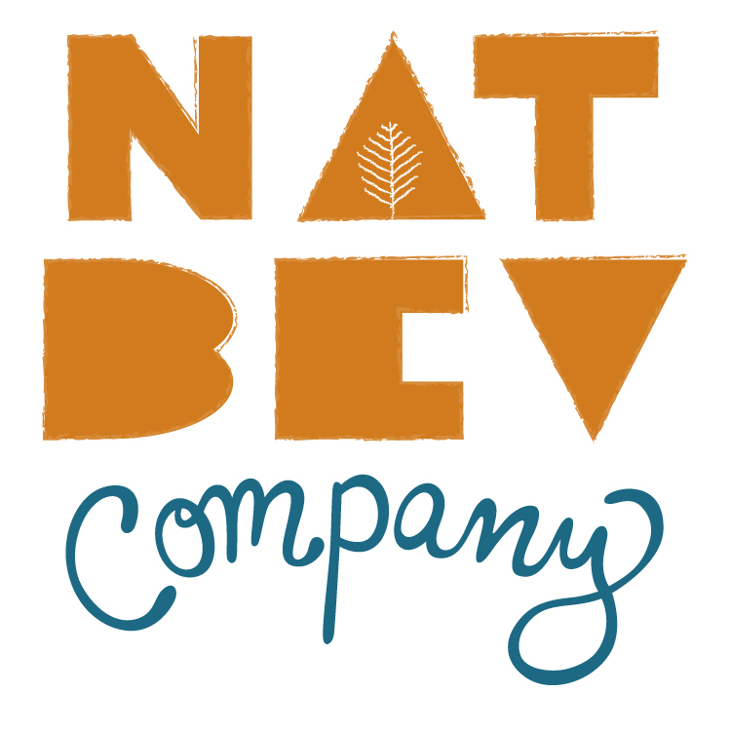


Slide 12



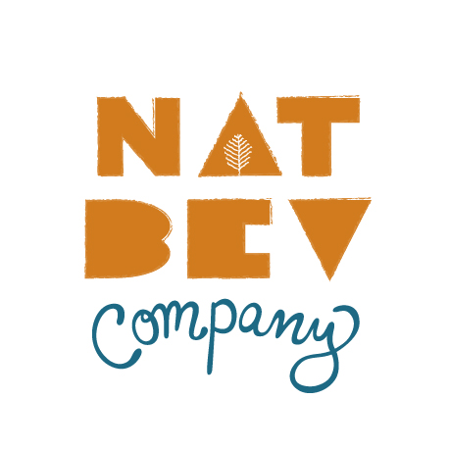



Slide 13

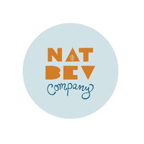



Slide 14


Phase 1:
Increase brand and product awareness
#pecanmyway
Filming and sharing blind taste test results
Phase 2:
Launch the product
#yespecan
Launch events with local businesses
Distribution of promotional materials (stickers, etc.)
Phase 3:
Maintain a consistent brand image
Periodic, scheduled posts on media platforms
Keep customers aware of where to find Native products as you expand

Slide 15

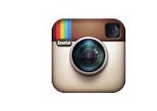



  #pecanmyway
  #yespecan

Slide 16





Slide 17

 | Facebook | Twitter
Year 1 | 500 likes | 80 followers
Year 2 | 1000 likes | 140 followers

Slide 18




Slide 19

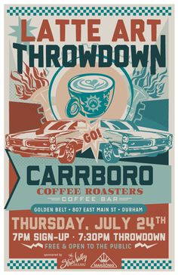

Slide 20




Slide 21
Year | Partnership Goal
1 | 2 clear contracted partnerships
2 | +1 clear contracted partnerships
3 | Selling retail in 3 coffee shops
4 | Selling retail in 3 coffee shops and small market
5 | Licensed partnerships with Fullsteam and Locopops

Slide 22

Marketing Budget
Type |  | Year 1 | Year 2
Website | Squarespace | $96.00 | $96
Stickers |  | $220 | $220
BP Booklet |  | $136 | $136
Business Cards | 500 | $20 | $20
Posters |  | $25 | $25
T-shirts |  | $50 | $50
Sampling
 | Plan milk samples | $636 | $700
 | 1200 samples
 | Samples in coffee | $558 | $600
 | 1800 samples
Promotions
 | Ads | $100 | $100
 | Splurgy
 | 1 free bottle/ month | $36 | $36
 | Frequent Buyer program | $90 | $180
Events |  | $300 | $300
 |  | $2,267.00 | $2,463

Slide 23


